Slide 1


Data Analytics and Visualization Job Simulation

Slide 2


Today's agenda
Project recap
Problem
The Analytics team
Process
Insights
Summary

Slide 3

Social Buzz, a rapidly growing social media platform, needs Accenture’s help! To prove our expertise, we are initiating a 3-month project to help achieve their goals.
Project Recap
Project Overview
Audit of their big data practice
IPO recommendations
Analysis of of content category popularity

Slide 4


Problem
Over 100,000 content postings daily, managing this unstructured data requires expensive and complex technology
80% of their workforce is dedicated to maintaining said technology
First Task at Hand
Analyze popularity of content categories

Slide 5



Andrew Fleming
Chief Technical Architect
The Analytics team
Marcus Rompton
Senior Principle
Austin Cicale
Aspiring Data Analyst

Slide 6
Data Selection
Selected datasets containing content characteristics and types of reactions
Process
1
2
Data Cleaning
Removed empty observations and unnecessary variables
3
Data Merging
Consolidated all relevant information into one data table
Accumulate Reaction Scores
Calculated total reaction scores for each category by summing across all observations
4
5
Identify Popular Content Categories
Established categories with the highest accumulated reaction scores, indicating popularity

Slide 7

Insights
Top 5 Content Categories
Animals
Science
Healthy Eating
Technology
Food
Top 5 Reaction Types
Heart
Scared
Peeking
Hate
Interested
Top 5 Months
May
January
August
December
July

Slide 8
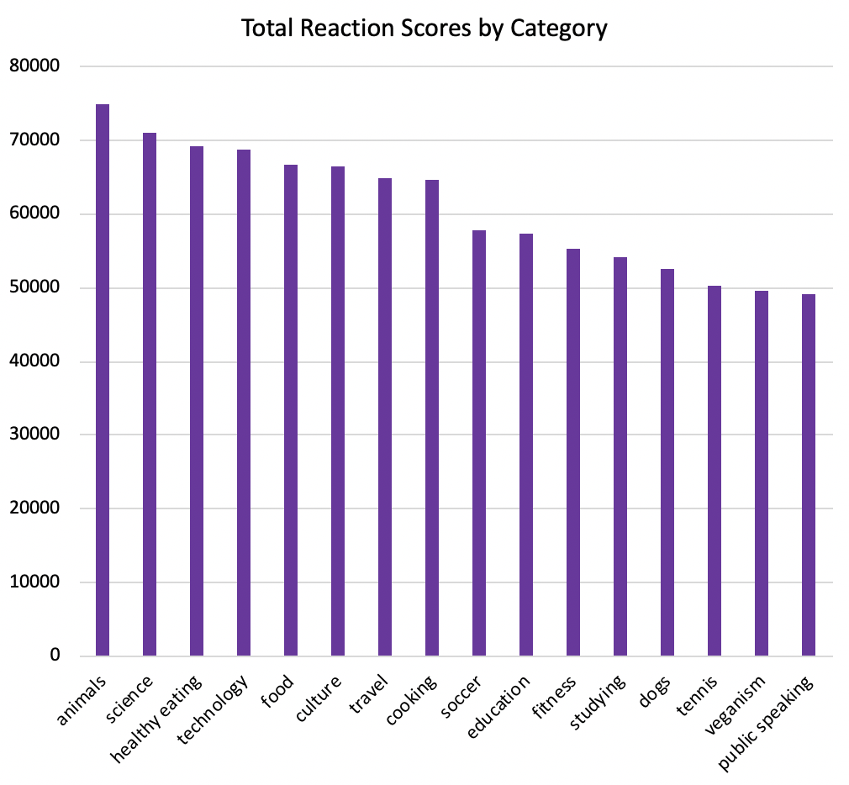
16 Different Categories
Animal content is most popular (74965)
Public Speaking content is least popular (49265)

Slide 9
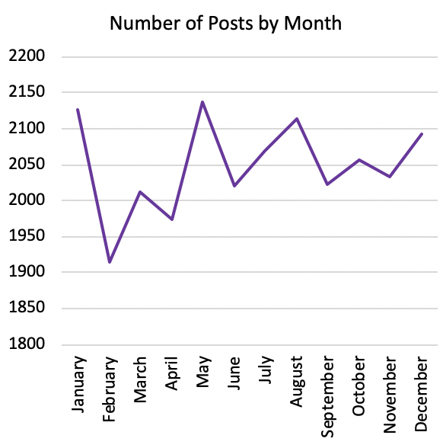
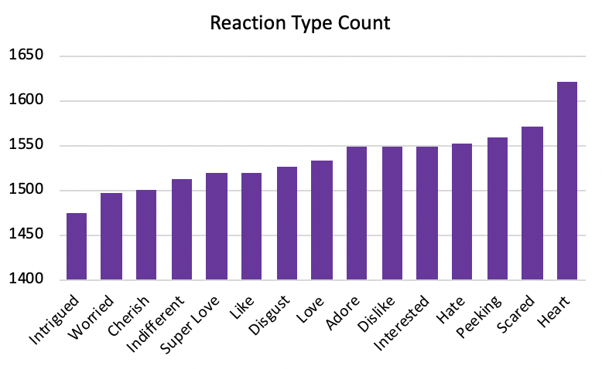
15 Different Reaction Types
Heart is the most popular with a usage count of 1622
Intrigued is the least popular with a usage count of 1475
May is the most popular month (2138 posts)
February is the least popular month (1914 posts)

Slide 10

OBJECTIVE
Analyze popularity of content categories
PROCESS
Select, clean, and merge relevant data
Accumulate reaction scores to identify popular content categories
Summary
FINDINGS
Top Content Categories
Animals
Science
Healthy Eating
Technology
Food

Slide 11

Thank you!
ANY QUESTIONS?

